Slide 1
GIBBS FREE ENERGY

Slide 2
In thermodynamics, the Gibbs free energy (IUPAC recommended name: Gibbs energy or Gibbs function; also known as free enthalpy to distinguish it from Helmholtz free energy) is a thermodynamic potential that can be used to calculate the maximum or reversible work that may be performed by a thermodynamic system at a constant temperature and pressure (isothermal, isobaric). Just as in mechanics, where the decrease in potential energy is defined as maximum useful work that can be performed, similarly different potentials have different meanings. The decrease in Gibbs free energy (kJ in SI units) is the maximum amount of non-expansion work that can be extracted from a thermodynamically closed system (one that can exchange heat and work with its surroundings, but not matter); this maximum can be attained only in a completely reversible process. When a system transforms reversibly from an initial state to a final state, the decrease in Gibbs free energy equals the work done by the system to its surroundings, minus the work of the pressure forces.
The Gibbs energy (also referred to as G) is also the thermodynamic potential that is minimized when a system reaches chemical equilibrium at constant pressure and temperature. Its derivative with respect to the reaction coordinate of the system vanishes at the equilibrium point. As such, a reduction in G is a necessary condition for the spontaneity of processes at constant pressure and temperature.
The Gibbs free energy, originally called available energy, was developed in the 1870s by the American scientist Josiah Willard Gibbs. In 1873, Gibbs described this "available energy" as
the greatest amount of mechanical work which can be obtained from a given quantity of a certain substance in a given initial state, without increasing its total volume or allowing heat to pass to or from external bodies, except such as at the close of the processes are left in their initial condition.
The initial state of the body, according to Gibbs, is supposed to be such that "the body can be made to pass from it to states of dissipated energy by reversible processes." In his 1876 magnum opus On the Equilibrium of Heterogeneous Substances, a graphical analysis of multi-phase chemical systems, he engaged his thoughts on chemical free energy in full.

Slide 3
History
The quantity called "free energy" is a more advanced and accurate replacement for the outdated term affinity, which was used by chemists in the earlier years of physical chemistry to describe the force that caused chemical reactions.
In 1873, Willard Gibbs published A Method of Geometrical Representation of the Thermodynamic Properties of Substances by Means of Surfaces, in which he sketched the principles of his new equation that was able to predict or estimate the tendencies of various natural processes to ensue when bodies or systems are brought into contact. By studying the interactions of homogeneous substances in contact, i.e., bodies composed of part solid, part liquid, and part vapor, and by using a three-dimensional volume-entropy-internal energy graph, Gibbs was able to determine three states of equilibrium, i.e., "necessarily stable", "neutral", and "unstable", and whether or not changes would ensue. Further, Gibbs stated:
If we wish to express in a single equation the necessary and sufficient condition of thermodynamic equilibrium for a substance when surrounded by a medium of constant pressure p and temperature T, this equation may be written:
δ(ε − Tη + pν) = 0 when δ refers to the variation produced by any variations in the state of the parts of the body, and (when different parts of the body are in different states) in the proportion in which the body is divided between the different states. The condition of stable equilibrium is that the value of the expression in the parenthesis shall be a minimum.
In this description, as used by Gibbs, ε refers to the internal energy of the body, η refers to the entropy of the body, and ν is the volume of the body.
Thereafter, in 1882, the German scientist Hermann von Helmholtz characterized the affinity as the largest quantity of work which can be gained when the reaction is carried out in a reversible manner, e.g., electrical work in a reversible cell. The maximum work is thus regarded as the diminution of the free, or available, energy of the system (Gibbs free energy G at T = constant, P = constant or Helmholtz free energy F at T = constant, V = constant), whilst the heat given out is usually a measure of the diminution of the total energy of the system (internal energy). Thus, G or F is the amount of energy "free" for work under the given conditions.
Until this point, the general view had been such that: "all chemical reactions drive the system to a state of equilibrium in which the affinities of the reactions vanish". Over the next 60 years, the term affinity came to be replaced with the term free energy. According to chemistry historian Henry Leicester, the influential 1923 textbook Thermodynamics and the Free Energy of Chemical Substances by Gilbert N. Lewis and Merle Randall led to the replacement of the term "affinity" by the term "free energy" in much of the English-speaking world.

Slide 4
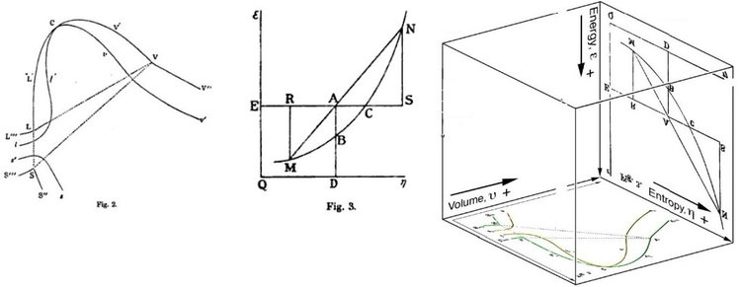
Graphical interpretation
Gibbs free energy was originally defined graphically. In 1873, American scientist Willard Gibbs published his first thermodynamics paper, "Graphical Methods in the Thermodynamics of Fluids", in which Gibbs used the two coordinates of the entropy and volume to represent the state of the body. In his second follow-up paper, "A Method of Geometrical Representation of the Thermodynamic Properties of Substances by Means of Surfaces", published later that year, Gibbs added in the third coordinate of the energy of the body, defined on three figures. In 1874, Scottish physicist James Clerk Maxwell used Gibbs' figures to make a 3D energy-entropy-volume thermodynamic surface of a fictitious water-like substance. Thus, in order to understand the very difficult concept of Gibbs free energy one must be able to understand its interpretation as Gibbs defined originally by section AB on his figure 3 and as Maxwell sculpted that section on his 3D surface figure.

Slide 5
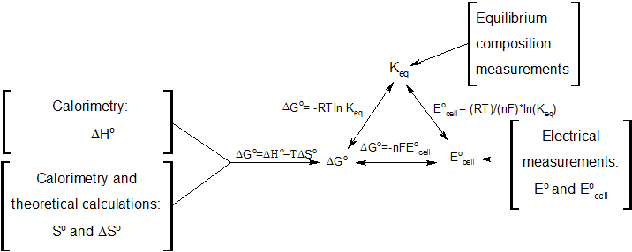
Definitions
The Gibbs free energy is defined as:
G(p,T)=U + pV - TS
which is the same as:
G(p,T)=H - TS
where:
U is the internal energy (SI unit: joule)
p is pressure (SI unit: pascal)
V is volume (SI unit: m³)
T is the temperature (SI unit: kelvin)
S is the entropy (SI unit: joule per kelvin)
H is the enthalpy (SI unit: joule)

Slide 6
Gibbs Energy in Reactions
Spontaneous - is a reaction that is consider to be natural because it is a reaction that occurs by itself without any external action towards it. Non spontaneous - needs constant external energy applied to it in order for the process to continue and once you stop the external action the process will cease. When solving for the equation, if change of G is negative, then it's spontaneous. If change of G is positive, then it's non spontaneous. The symbol that is commonly used for FREE ENERGY is G, can be more properly considered as "standard free energy change“.
In chemical reactions involving the changes in thermodynamic quantities, a variation on this equation is often encountered:
ΔG (change in free energy) = ΔH (change in enthalpy)−TΔS((temperature) (change in entropy))
Since the changes of entropy of chemical reaction are not measured readily, thus, entropy is not typically used as a criterion. To obviate this difficulty, we can use GG. The sign of ΔG indicates the direction of a chemical reaction and determine if a reaction is spontaneous or not.
ΔG<0 : reaction is spontaneous in the direction written (i.e., the reaction is exergonic)
ΔG=0 : the system is at equilibrium and there is no net change either in forward or reverse direction
ΔG>0 : reaction is not spontaneous and the process proceeds spontaneously in the reverse direction. To drive such a reaction, we need to have input of free energy (i.e., the reaction is endergonic)

Slide 7
APPLICATIONS OF GIBBS FREE ENERGY IN ELECTROCHEMISTRY
Useful identities to derive the Nernst equation.
Gibbs free energy, the second law of thermodynamics, and metabolism.
To find the spontaneity of the reaction.

Slide 8
1. Useful identities to derive the Nernst equation
During a reversible electrochemical reaction at constant temperature and pressure, the following equations involving the Gibbs free energy hold:
∆rG = ∆rG° + RT lnQr
∆rG° = -RT lnK
∆rG = -nFE
∆rG° = -nFE°
And rearranging gives
nFE° = RT lnK
nFE = nFE°- RT lnQr
E = E° - RT lnQr
nF
which relates the cell potential resulting from the reaction to the equilibrium constant and reaction quotient for that reaction (Nernst equation).

Slide 9
where
Δ_{r}G = Gibbs free energy change per mole of reaction
Δ_{r}G° = Gibbs free energy change per mole of reaction for unmixed reactants and products at standard conditions
R = gas constant
T = absolute temperature (in K)
ln = natural logarithm
Q_{r} = reaction quotient (unitless)
K = equilibrium constant (unitless)
w_{elec,rev} = electrical work in a reversible process (chemistry sign convention)
n = number of moles of electrons transferred in the reaction
F = Faraday constant = 96485 C/mol (charge per mole of electrons)
E = cell potential (in V)
Moreover, we also have:
Keq = e^ (-∆rG°/RT)
∆rG° = -RT ln K eq = -2.303 RT (log10 Keq )

Slide 10
2. Gibbs free energy, the second law of thermodynamics, and metabolism
A chemical reaction will (or can) proceed spontaneously if the change in the total entropy of the universe that would be caused by the reaction is nonnegative. As discussed in the overview, if the temperature and pressure are held constant, the Gibbs free energy is a (negative) proxy for the change in total entropy of the universe. It is "negative" because S appears with a negative coefficient in the expression for G, so the Gibbs free energy moves in the opposite direction from the total entropy. Thus, a reaction with a positive Gibbs free energy will not proceed spontaneously. However, in biological systems (among others), energy inputs from other energy sources (including the sun and exothermic chemical reactions) are "coupled" with reactions that are not entropically favored (i.e. have a Gibbs free energy above zero). Taking into account the coupled reactions, the total entropy in the universe increases. This coupling allows endergonic reactions, such as photosynthesis and DNA synthesis, to proceed without decreasing the total entropy of the universe. Thus biological systems do not violate the second law of thermodynamics.

Slide 11
3. To Find Spontaneity of the Reaction
In chemistry, the Gibbs energy is useful because it relates properties of a system with the entropy change of the universe. To predict whether a reaction is spontaneous, we need to know how it affects the entropy of the universe. We can do so by calculating ΔG=ΔH−TΔS=ΔU+PΔV−TΔS. Note that this only makes reference to the pressure, volume, temperature, and entropy of the system, and not of the surroundings. If ΔG is positive, then the entropy change of the universe is negative, and vice versa. This only holds when reactions are carried out at constant temperature and constant pressure, which is most often the case in chemistry. These constraints allow us to relate the entropy change of the universe to intensive and extensive quantities of the system. The Gibbs energy is much less useful under other conditions. Gibbs energy is also a measure of the amount of work that can be extracted from a system (again at constant temperature and pressure). This is because the enthalpy measures the energy that can be extracted from a system, but then we have to subtract TΔS because that energy is released in the form of heat, and the efficiency of a heat engine is zero when both reservoirs are at the same temperature. The name "Gibbs energy" is recommended by the IUPAC over "Gibbs free energy".

